Slide 1


Offuture - Descriptive Analytics

Slide 2


Project overview
Project one is a descriptive analytics project.
Descriptive Analytics – “What Happened”?
You’ll be assigned a group of ~4 members
Key objectives
Analyse the data: The data is loaded into SQL for you. Analyse the dataset to see the company performance over time.
Visualisation & Story Telling: Visualise the data to explore data and find your key points. Think about how to present the data in a logical way.
Present: Groups will be delivering their final work to the Digital Futures team.

Slide 3



Introducing Offuture
Offuture is an online global office & technology supply store
The store has been running online since 2010 and delivers high quality office furniture, technology and office supplies across the globe

Slide 4


The Situation
In 2020, Offuture appointed a well-known consultancy to explore their sales data and build a data model to predict future sales.
At first the process went well, until the final presentation – the consultant quoted some facts & figures about Offuture’s performance that Hamish Boxworth, the CEO of Offuture, knew to be wrong.
With the trust lost, Hamish decided that he couldn’t trust any of the work produced by the consultancy company.

Slide 5

The Brief
Offuture has approached your consultancy firm to produce a proof of concept.
Offuture are confident they know the performance break down of their business from 2011 to 2015 – they want to see proof that your team can produce accurate trustworthy results, before engaging with you further to produce predictive models.
Offuture are providing a data file of their sales from 2011 to 2015. They would like you to conduct a Descriptive Analytics project to detail their performance during the time period.
Offuture have no specific questions for this proof of concept. They want you to describe the performance from the data.

Slide 6
Some Starter Points
Total Sales across each year / month / qtr
Total Profit across each year / month / qtr
Total sales/profit across each year…. By category, sub-category, or segment.
Top performing products (most sold? Most profitable?)
Worst performing products (least profitable?)

Slide 7
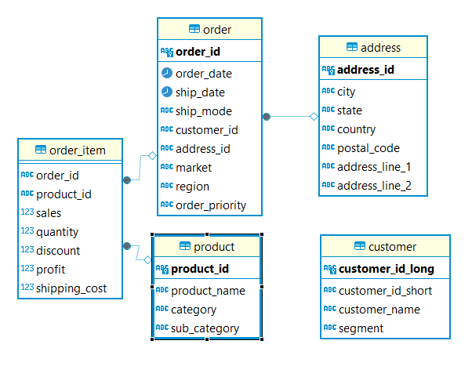
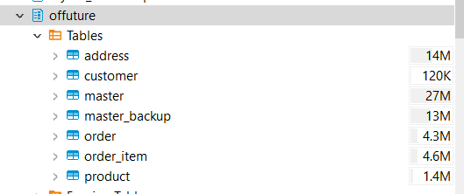
The Data

Slide 8
Deliverable
In your assigned teams:
Key objectives
Analyse the data
Visualisation & Story Telling:
Tableau presentation file (on Tableau Public)
Present:
Live presentation to the DF team
(Teams choice of format, PowerPoint, PDF, google docs etc)
Presentations on morning of Friday 3rd October
Notes:
Change dates

Slide 9



Slide 10

Extra little DATA tips!
Start with trying to get to replicate the “master data” -> explore IDs!
Theres many ways to love the ID problem -> UNION is your friend!
Views are excellent! Remember GRANT SELECT On {{table}} to {{student}}
Work clean, save your queries, use comments, link queries together!
Data Quality, Data Quality, Data Quality
If the database slows down, tell me via Discord!

Slide 11
Extra little TEAMWORK tips!
Spend a bit of time getting to know each other!
Set up your communication lines first and foremost!
Use a collaborative environment to share things!
Delegate and Include each other!
Aim for a cohesive presentation -> yes delegate, but also, bring it back together.
The lone wolf leader who does everything never succeeds.
Learn, love, teach, be patient, grow together <3

Slide 12
Extra little PRESENTATION tips!
Every slide should add to your narrative
Your audience is the Client – it’s Offuture! Don’t offend them!
Remember you’re talking to Offuture, not about them!
Suggest but don’t tell. “Investigate”/”Consider”/”Evaluate” not “Get rid of X”

